Slide 1
CS551 Advanced Software Engineering
Tutorial 4
Android App Development using Android Studio

Slide 2
Topics
Android Studio installation.
Android App development using Android Studio

Slide 3
Android Studio Installation

Slide 4
Getting Started (1)
Need to install Java Development Kit (JDK) to write Java (and Android) programs
Do not install Java Runtime Environment (JRE); JDK and JRE are different!
Can download the JDK for your OS at http://java.oracle.com
Alternatively, for OS X, Linux:
OS X:
Open /Applications/Utilities/Terminal.app
Type javac at command line, install Java at prompt
Linux:
Debian/Ubuntu: sudo apt-­‐get install java-­‐package, download the JDK <jdk>.tar.gz file from Oracle, run make-­‐jpkg
<jdk>.tar.gz, then sudo dpkg –i <resulting-­‐deb-­‐file>
Fedora/OpenSuSE: download the JDK .rpm file from Oracle, install

Slide 5
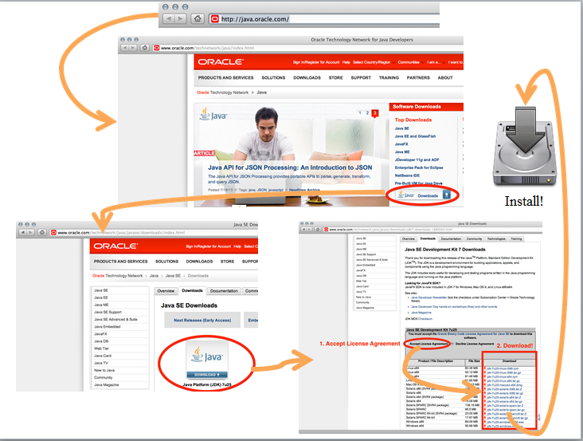
.

Slide 6
Getting Started (2)
After installing JDK, download Android SDK from http://developer.android.com
Simplest: download and install Android Studio bundle (including Android SDK) for your OS
Alternatives:
Download/install Android Developer Tools from this site (based on Eclipse)
Install Android SDK tools by themselves, then install ADT for Eclipse separately (from this site)
We’ll use Android Studio with SDK included (easy)

Slide 7
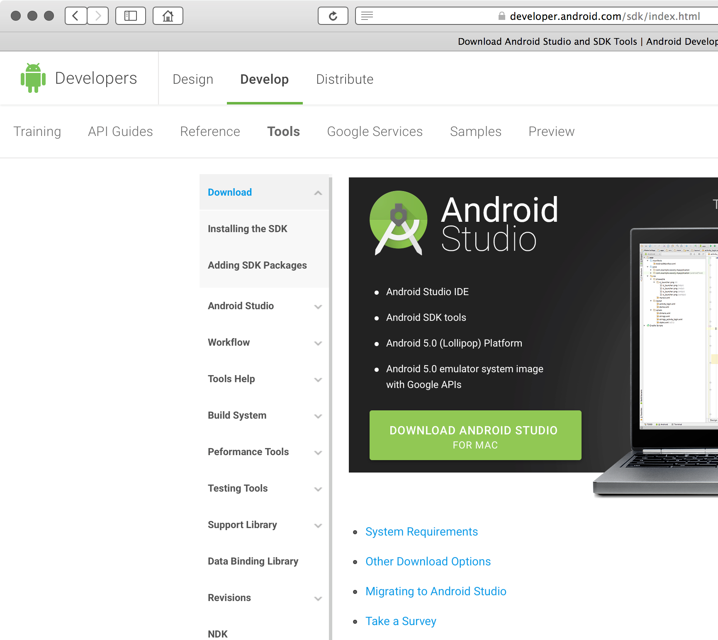

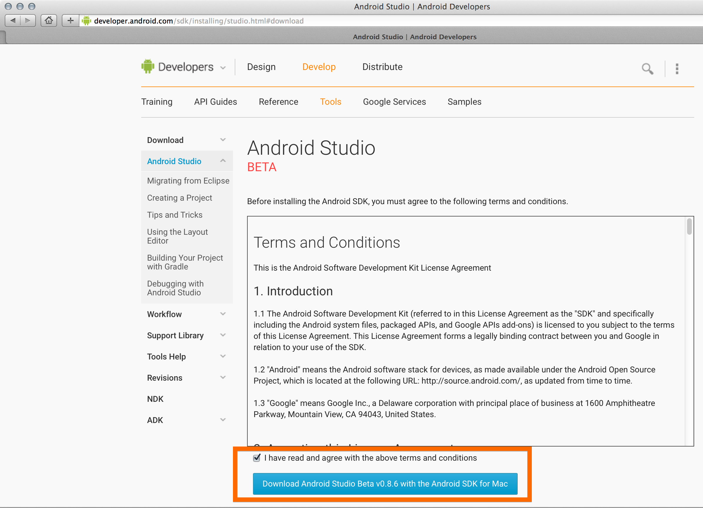
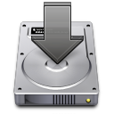
http://developer.android.com/sdk/index.html
Install!

Slide 8
Android Virtual Device Creation

Slide 9
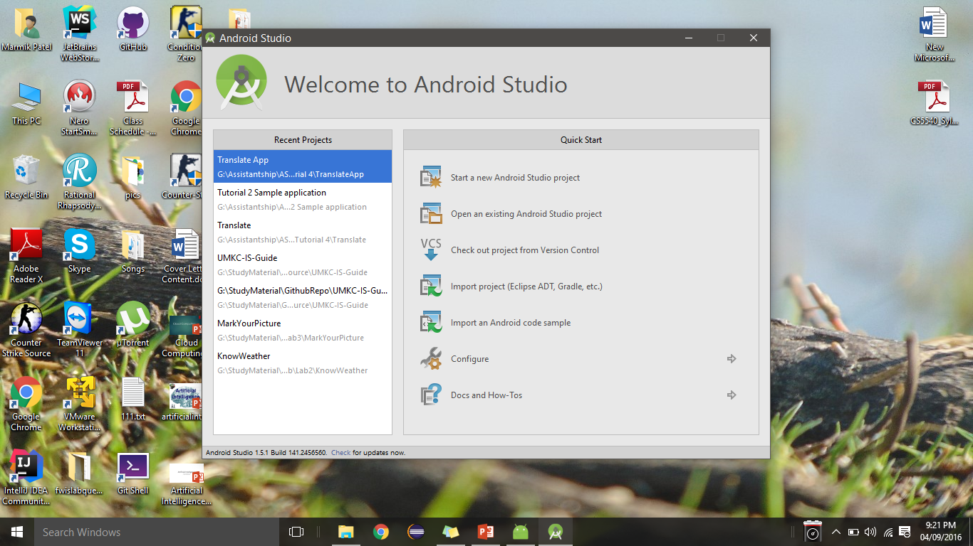
Open Android Studio
Click on the configure button

Slide 10
AVD Manager
Open Android studio->Click Tools -> Android -> SDK Manager->AVD Manager
Click on Create Virtual Device.
Select a device that you intend to emulate and click Next.
Select the OS that you want the device to run on. You need to download and install OS versions in case they are not there.
Finally name your AVD and configure it. Click Finish.

Slide 11
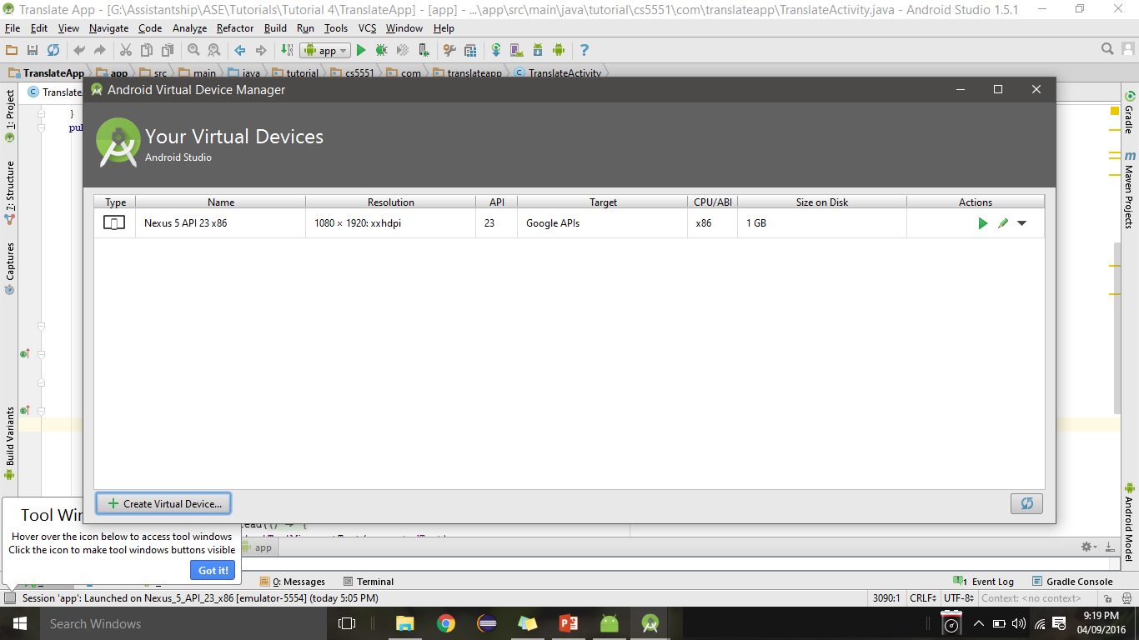
AVD Manager

Slide 12
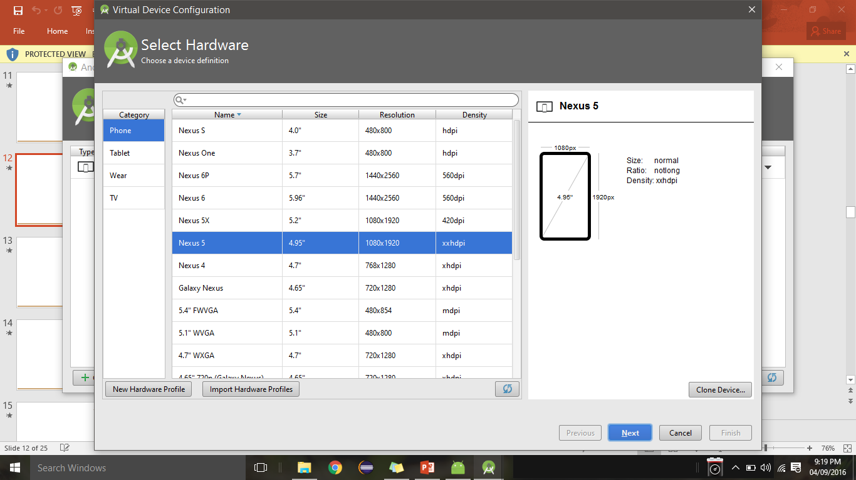
AVD Manager

Slide 13
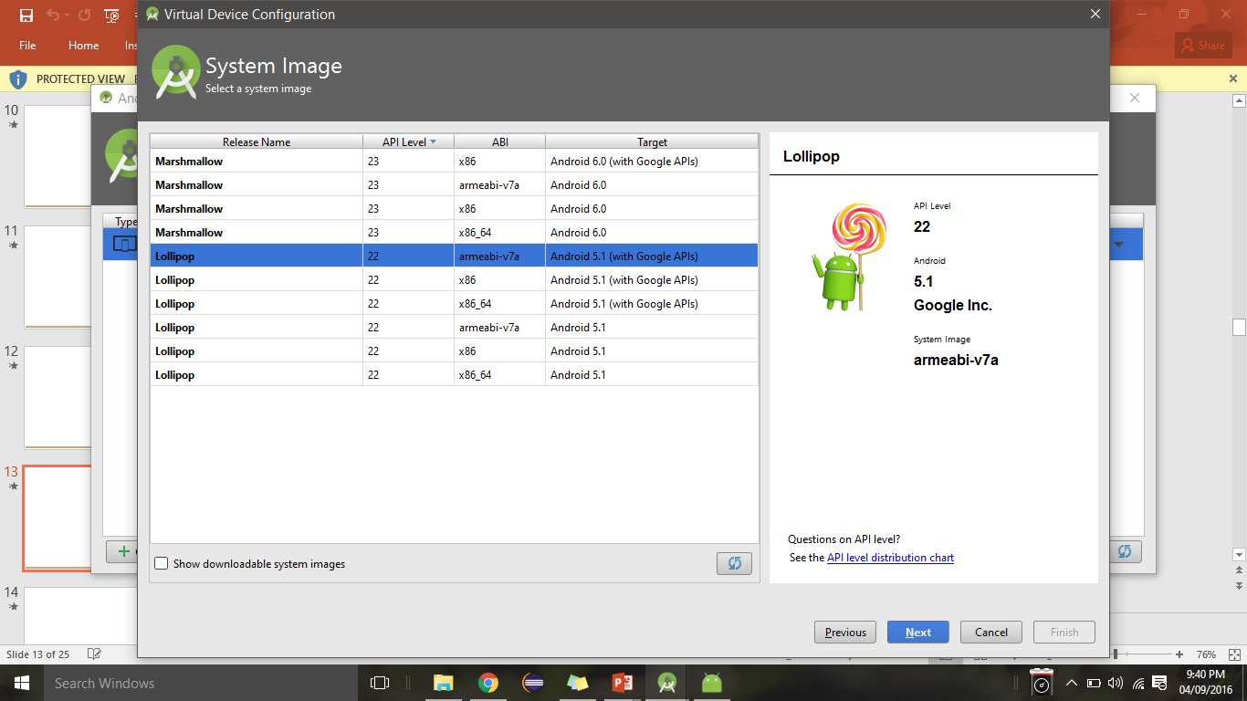
AVD Manager

Slide 14
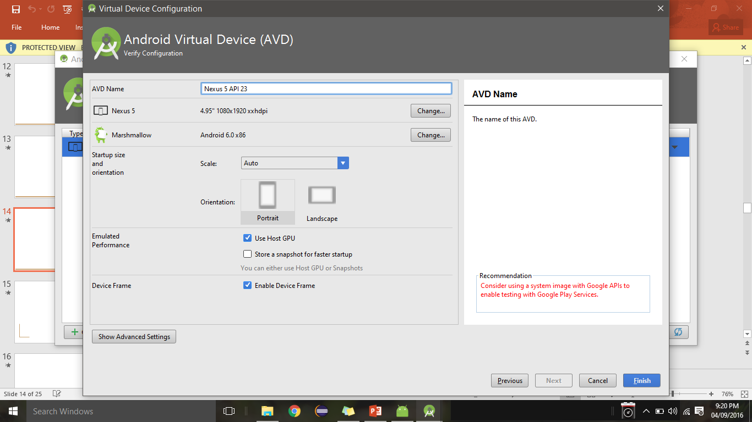
AVD Manager

Slide 15
Android App development

Slide 16
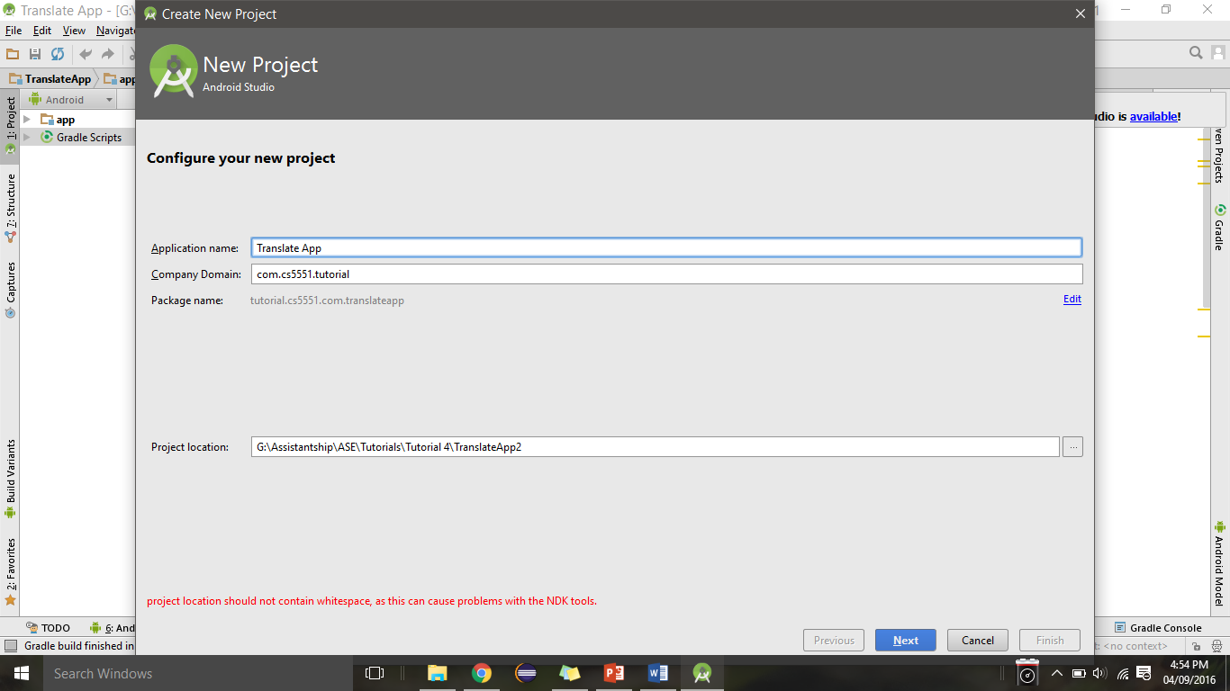
Creating a new Android application
Application name and domain

Slide 17
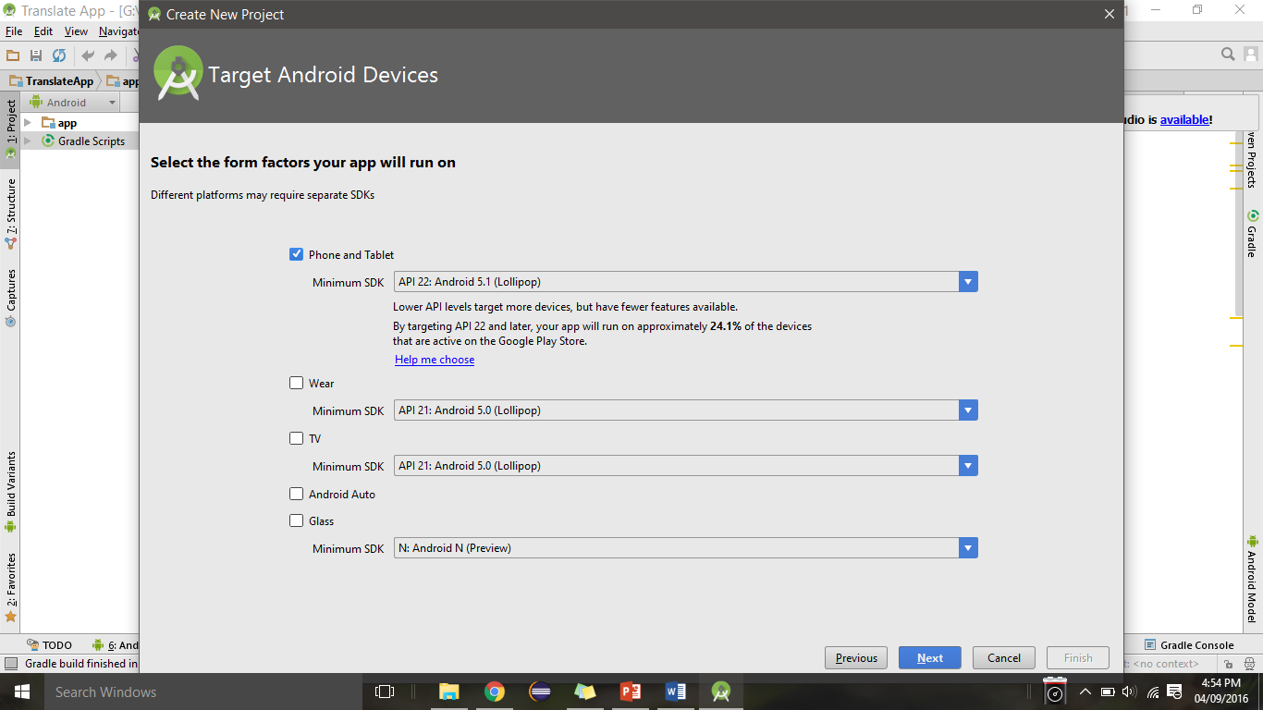
Selecting the SDK and type of device to deploy the application
1
2
The minimum SDK version that you want your app to run on. It is better to prefer a version that is stable and
new
2. In case you want your app to deployed on smart watches and other wearable device.

Slide 18
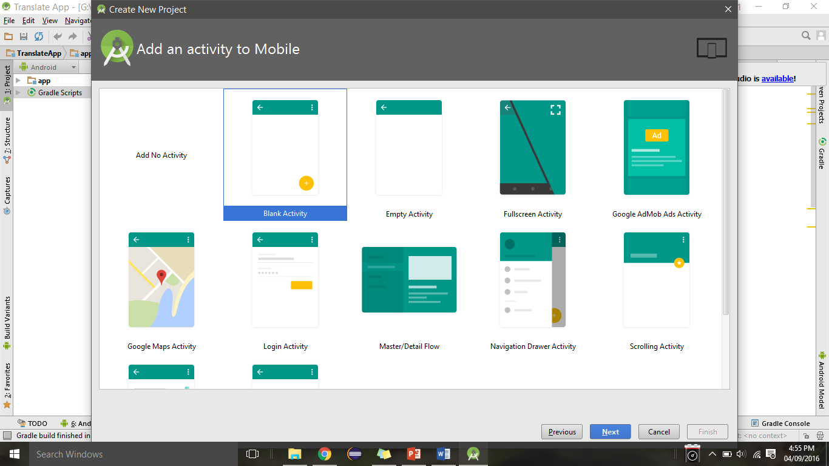
Selecting the type of activity for the application
You can choose from various templates available to start off the application. It is better to choose a
Blank activity as you could add and manage the controls as you need.

Slide 19
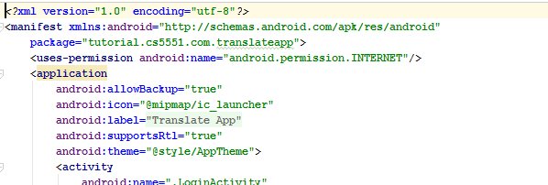
Android Manifest
Do not forget to add internet permission in AndroidManifest.xml file to enable internet access in device/emulator

Slide 20
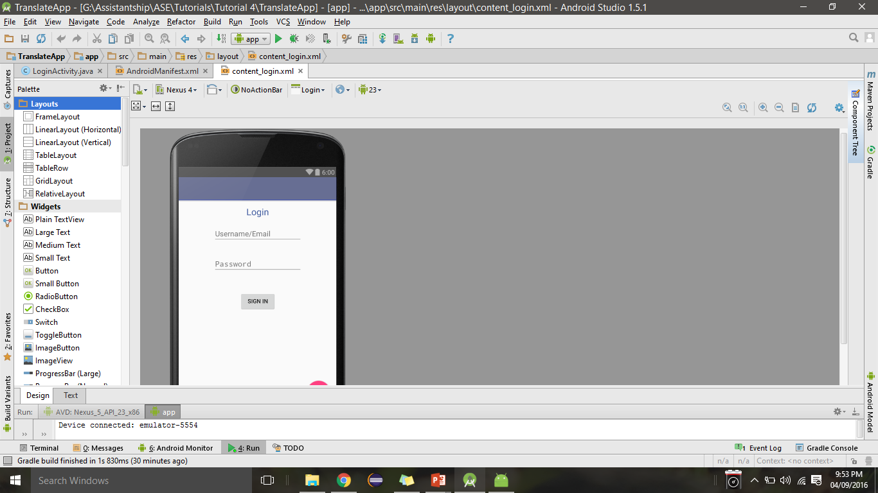
Controls in the application provided in tutorial
TextView Control
EditText Controls
Button Control
Explore the other controls present in the SDK in your lab exercises.

Slide 21
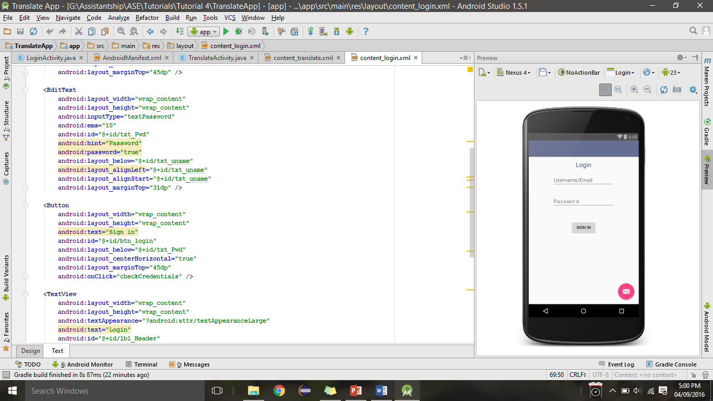
activity_sample.xml

Slide 22
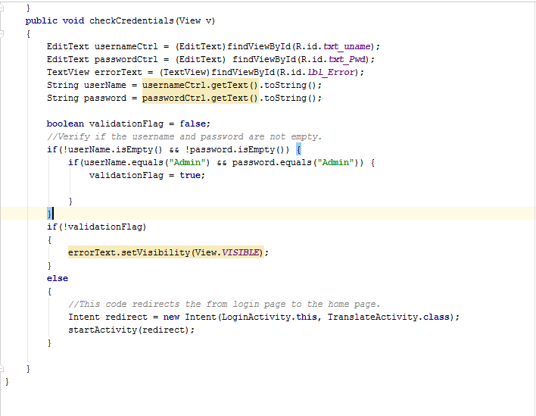
Code for login…...
Accessing the UI controls to get the username and password
Redirecting to the web service page on successful login.

Slide 23
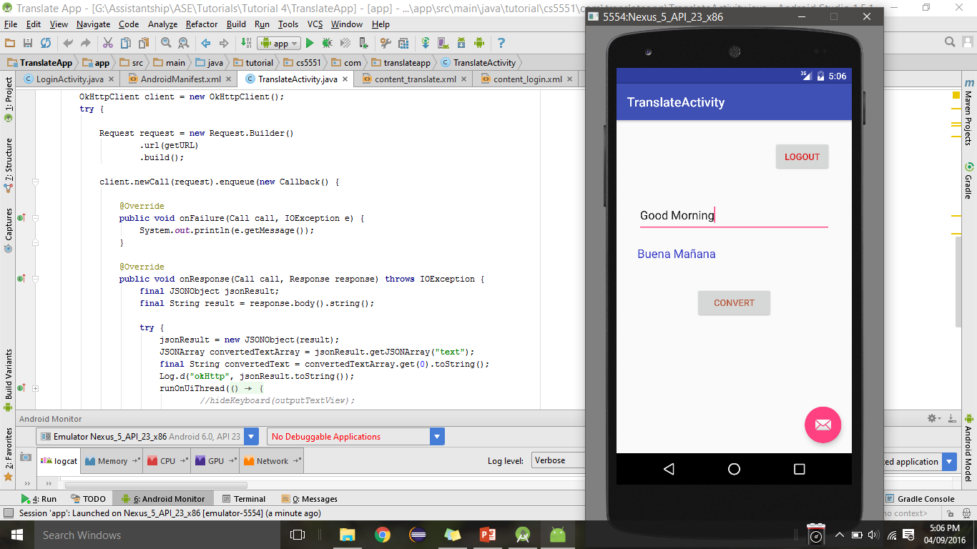
Snapshot of the Translate activity for the tutorial application
Source text
Translated text

Slide 24
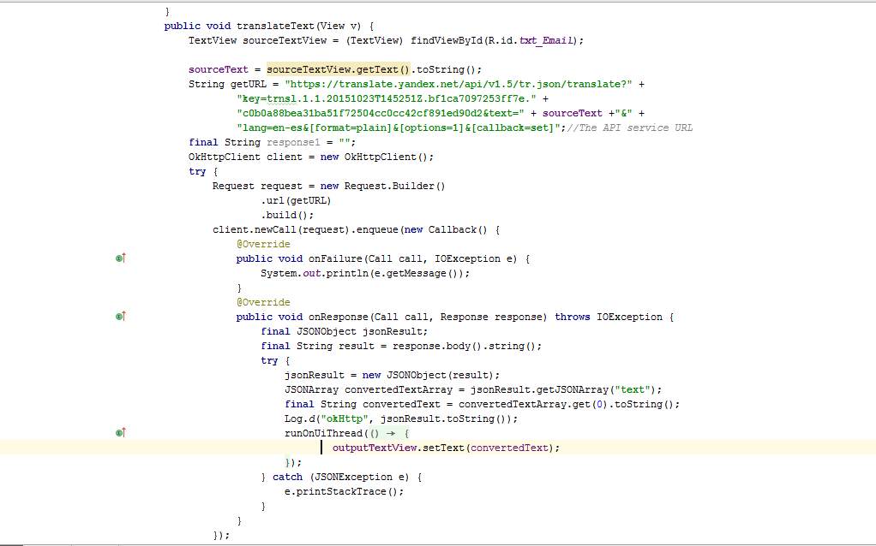
Translate web service code...
Accessing the UI controls
JSON web parsing of web service response
Populating the UI with the translated text

